Slide 1

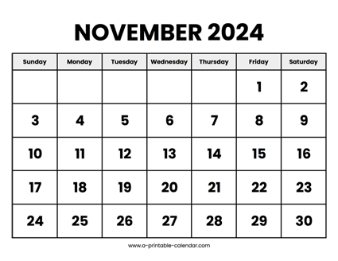
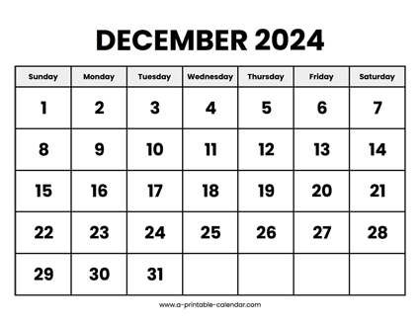

CS 310 : Scalable Software Architectures
Class session on Tuesday, November 26th
Notes:
What's left?
Exam 02 on Tuesday 12/03
Final project due Friday 12/06
Project #04 due Friday 12/13 (finals week)
Class today?
Review for next Tuesday's exam
Exam covers all material since last exam

Slide 2
Security in Multi-tier Systems
Trust
HTTPS handshake
Certificates
Encryption
Best Practices
Authentication
Authorization

Slide 3
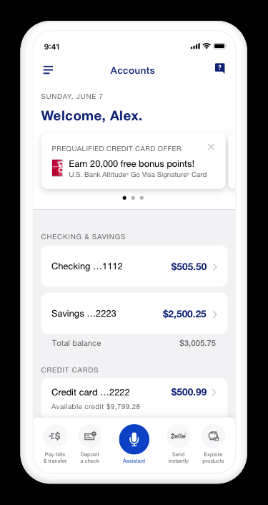
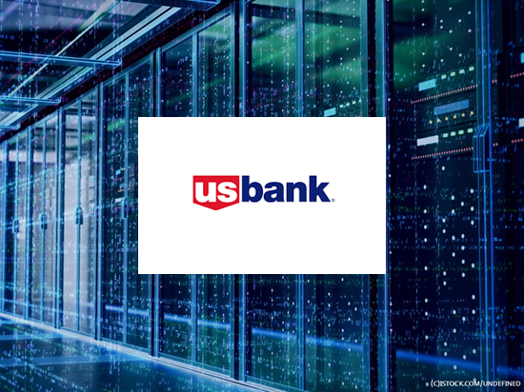
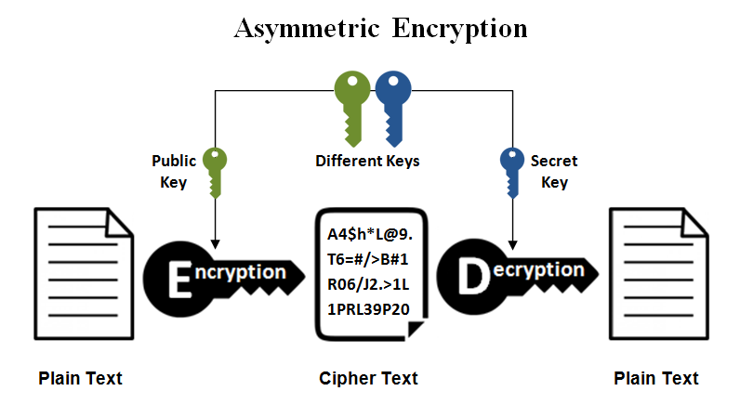
Public/private key encryption
Encryption is performed using a pair of keys
Private, secure communication is only guaranteed in one direction. Which direction is NOT private/secure? Why?
3

Slide 4
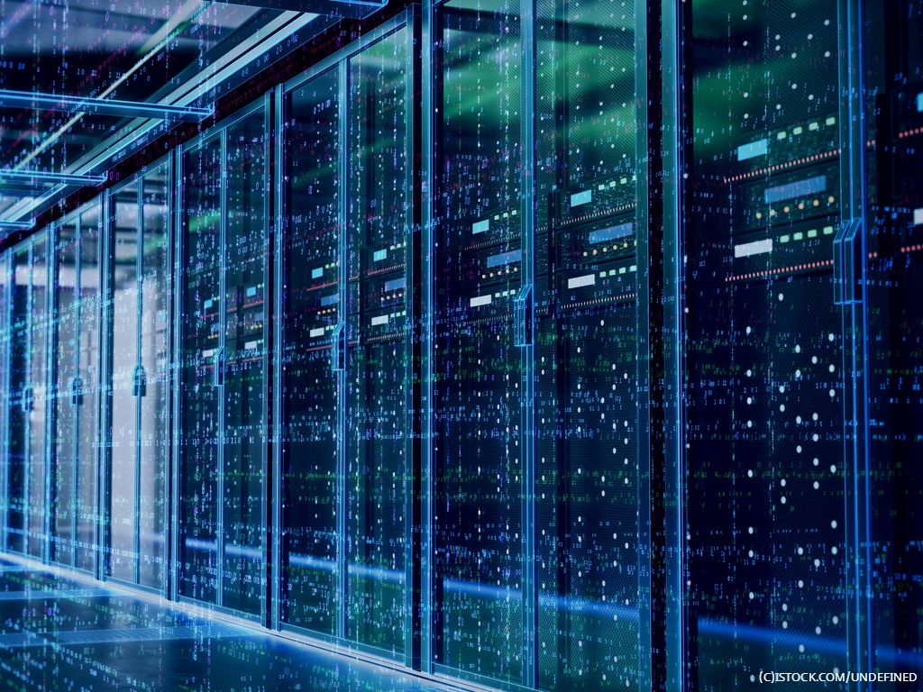
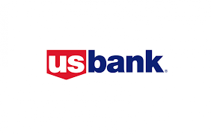
HTTPS "handshake"
HTTPS is designed for a client to securely obtain the server's public key
How does it prevent "person-in-the-middle" attacks?

Slide 5
HTTPS "handshake"
How does the handshake prevent attacks where the user is encouraged to enter/click the wrong URL?
Notes:
It doesn't :-(

Slide 6


Slide 7
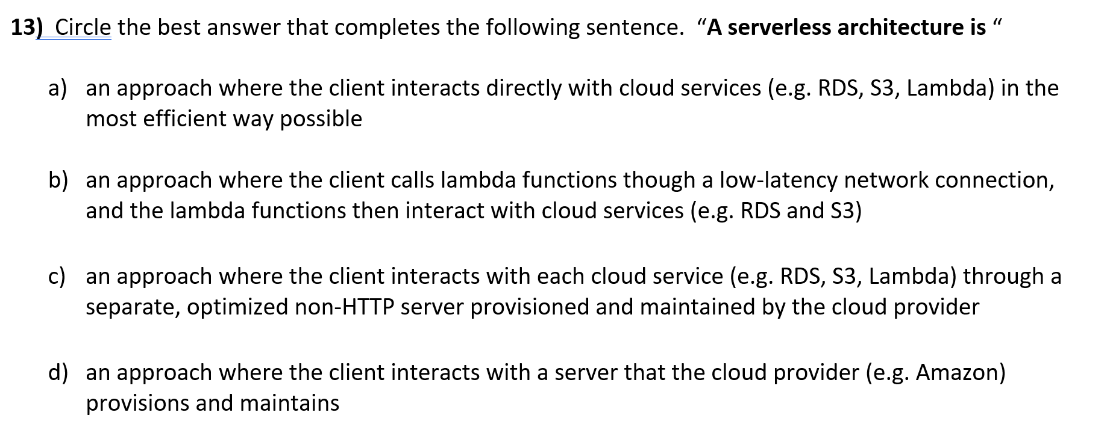
Serverless
Answer here: https://tinyurl.com/cs310-multi

Slide 8
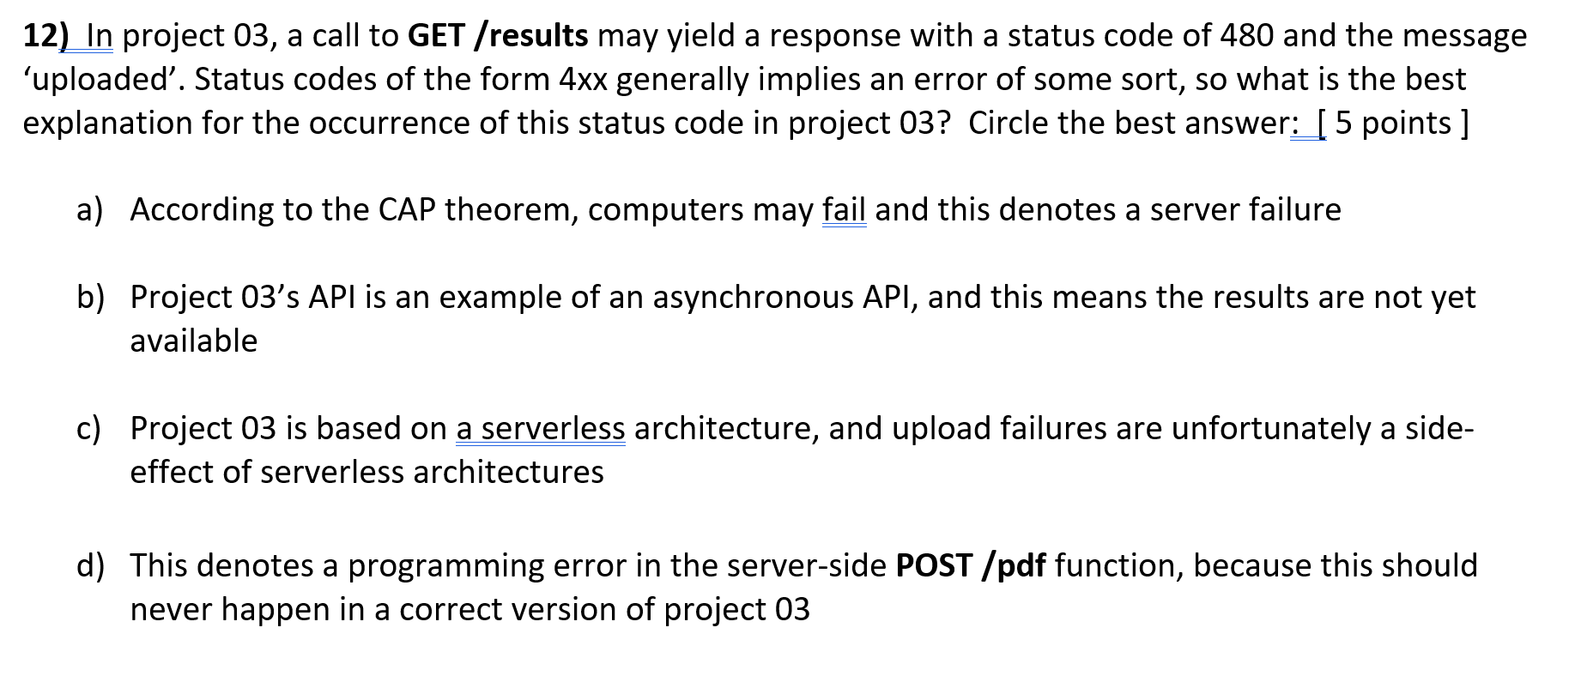
API Design
Answer here: https://tinyurl.com/cs310-multi

Slide 9
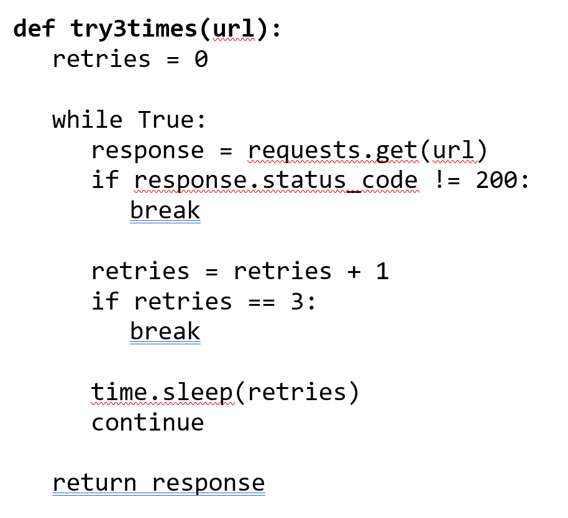
Polling
This function retries GET requests at most 3 times, returning the response. It doesn’t work. How would you fix the code?
Answer here: https://tinyurl.com/cs310-short

Slide 10
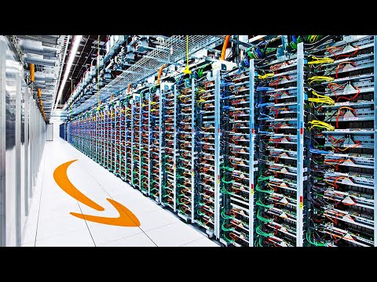
Lambda functions
With our web service written in JavaScript + Node.js, we understood that the code ran on a single-thread. Async programming allowed our web service to handle requests from multiple users in a timely way.
When we rewrote our web service using API Gateway + Lambda functions, the lambda functions were configured to run on the same virtual HW as Node.js --- simple 2-core virtual CPUs. From the perspective of supporting execution requests from multiple users in a timely way, should we have programmed our Lambda functions in an async manner? Why or why not?
Answer here: https://tinyurl.com/cs310-short

Slide 11
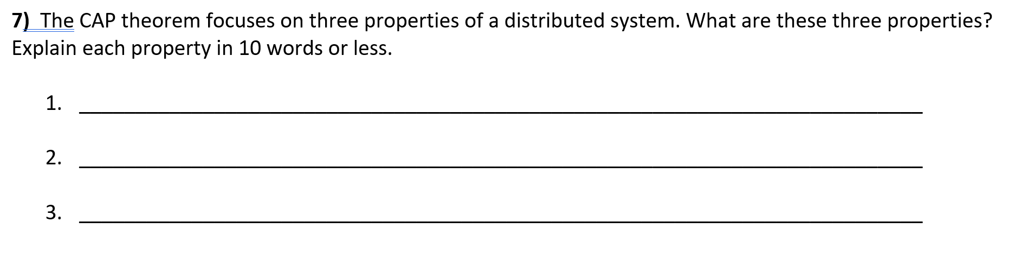
CAP Theorem
Which systems are the most common: CA, CP, or AP?
Answer here: https://tinyurl.com/cs310-short

Slide 12
CAP Theorem
Consistency: reads always return the most recent write (or an error)
Availability: every request receives a timely, non-error response
Partition tolerance: the system continues to operate even in the presence of failures (software, hardware, network, power, etc.)
Which systems are the most common? CP

Slide 13
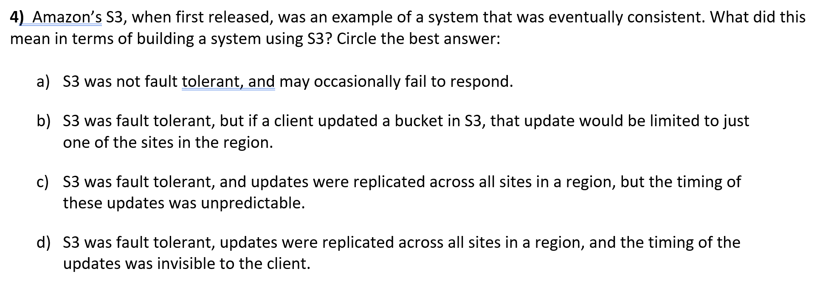
S3 design
Answer here: https://tinyurl.com/cs310-multi

Slide 14
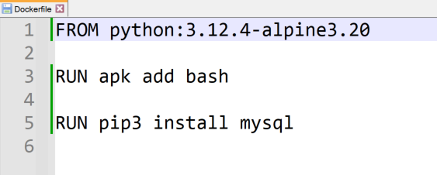
Docker
A Dockerfile is used to create a Docker image. Explain each line of this Dockerfile.

Slide 15
VMs
Why are Virtual Machine images so much larger than Docker images?
Answer here: https://tinyurl.com/cs310-short

Slide 16
Lambda layers
Why are Lambda layers so much smaller than Docker images?
Answer here: https://tinyurl.com/cs310-short

Slide 17
That's it, thank you!

Slide 18
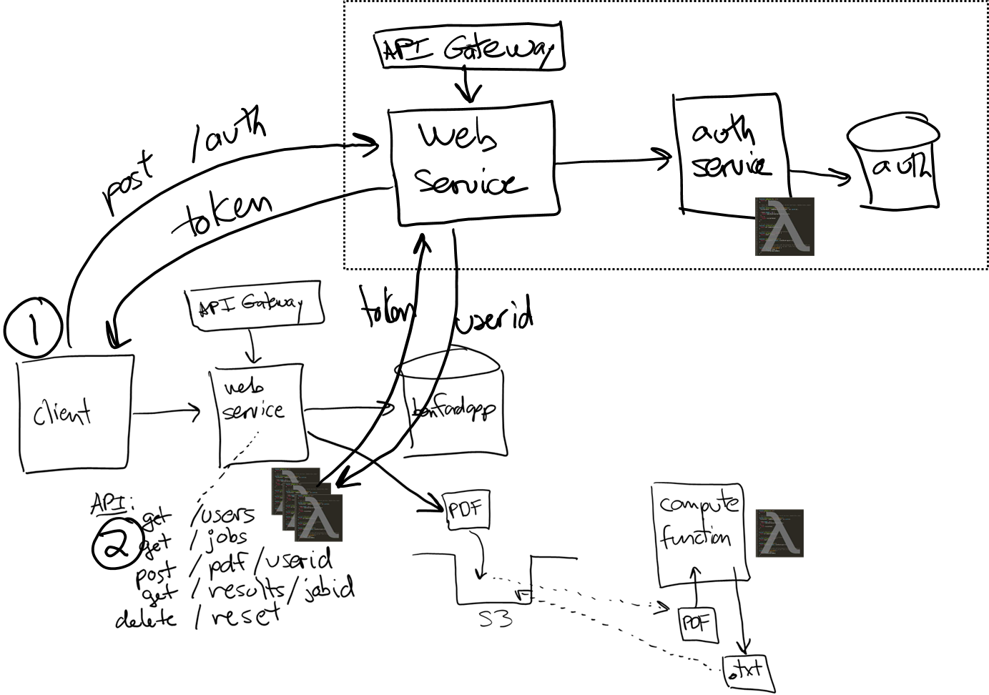
Project 04
Project 04 adds authentication (users & pwds)

